Slide 1

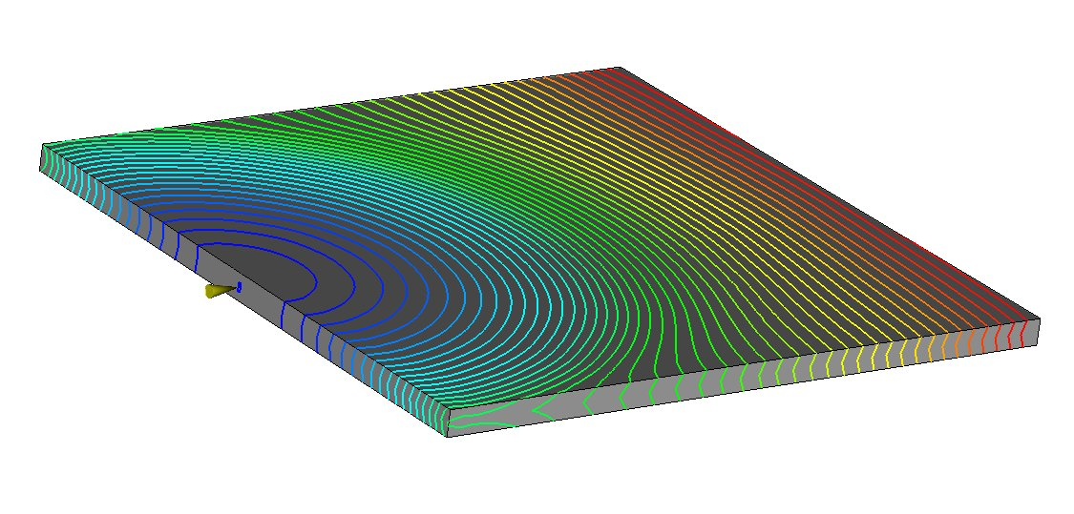
Rüdiger Deering CAE-Service
Melt
Melt speed
Shear rate
Fibre orientation

Slide 2
Abstract
Basic terms in rheology
Shear flow and stretch flow
Viscosity
Fill rate and pressure demand
pvt diagram
Fibre orientation in injection moulding
Mechanisms orienting the fibres
Examples
Fibre orientation at ribs
Fibre orientation at obstacles
Notes:
Intention of this training session is to teach Basics of Rheology.
Nevertheless, this session can only give a major overview about the topic of rheology and cannot cover all important aspects.
You will get an introduction about shear and stretch flow, about viscosity, fill rate, pressure demand and the pvt diagram. In a 2nd part you will learn about fibre orientation in the injection moulding process.
Lessons learned can be checked by yourself after the training.

Slide 3
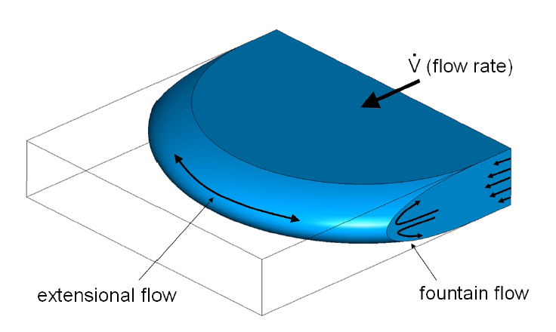
Shear Flow and Stretch Flow (1)
melt flow
stretch flow
shear flow
Notes:
When injecting a polymer into the cavity, the melt flow will be driven by two types of flow!
Shear flow and stretch flow.

Slide 4
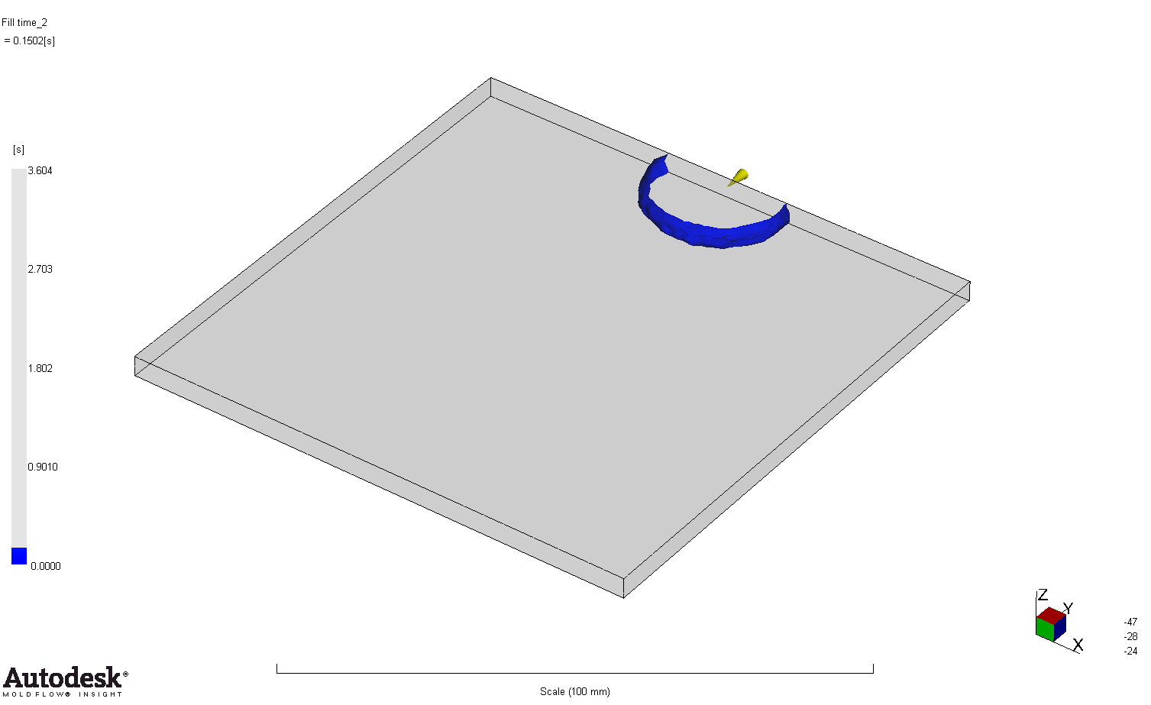
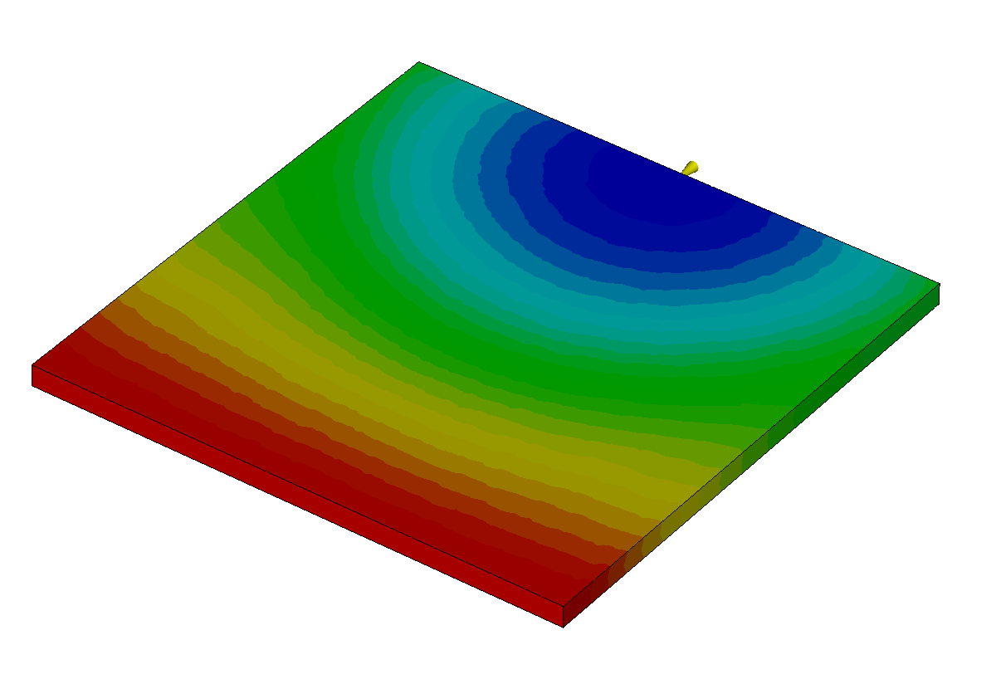
Shear Flow and Stretch Flow (2)
pin gate
stretch flow
flow pattern during filling a plate
Notes:
This example shows a plate with a bar or pin gate.
During filling of the 1st half we identify an increasing – or stretched - melt front, which generates the stretch flow,
In the 2nd half, the melt front does not increase anymore, thus stretch flow is becoming low.
Stretch flow is oriented mainly perpendicular to the melt propagation direction and dominates the melt in the core

Slide 5
Shear Flow and Stretch Flow (3)
shear
force F=0
force F>0
velocity v=0
velocity v>0
Notes:
Shear flow will be generated when a velocity gradient between cavity wall and core exists.

Slide 6
Shear Flow and Stretch Flow (3)
melt speed gradient across thickness
generated shear
zero velocity at wall (melt sticks at wall)
highest velocity in the centre
velocity profile
Notes:
Here we see a velocity profile.
There is no velocity at the wall. The melt sticks immediatly when touching the much colder wall of the tool.
The highest velocity will be in the centre.
The amount of change of velocity is called velocity gradient.
This velocity or melt speed gradient will generate shear causing a shear flow.

Slide 7
Shear Flow and Stretch Flow (3)
melt speed gradient across thickness
generated shear
shear flow
zero velocity at wall (melt sticks at wall)
highest velocity in the centre
highest shear rate at the border
velocity profile
shear profile
Notes:
To the right we see now a shear profile. There is high shear near the cavity walls and low shear in the core.
The shear profile depends directly on the velocity profile. The higher the velocity gradient, the higher the shear.
Shear Flow is oriented in melt propagation direction and dominates the melt near the wall.
The shear rate is a measure of how quickly the layers of the melt are sliding part each other.
If it happens to fast the polymer chains break and the material degrades.

Slide 8
Shear Flow and Stretch Flow (4)
melt speed gradient across thickness
generated shear
shear flow
zero velocity at wall (melt sticks at wall)
highest velocity in the centre
highest shear rate at the border
velocity profile
shear profile

Slide 9
Viscosity (1)
viscosity – try of a definition
~ equivalent to toughness of a material
a measure of resistance to flow
characteristic of material
for plastics non-newtonian
viscosity vs shear rate
shear thickening
viscosity
shear thinning
non-newtonian
decreasing viscosity with increasing shear rate cause -> disentaglement of macromolecules (shear thinning)
shear rate
Notes:
Now we come to the term of viscosity.
To the left, you find some tries of definition, for instance: viscosity is a measure of resistance to flow.
To the right viscosity as function of shear rate is shown.
The displayed viscosity describes a non-newtonian fluid. That means: with increasing shear rate viscosity is dropping, the flowability is becoming better.
Reason for this characteristic is an effect called shear thinning. Behind this effect is the forced disentaglement of polymer chains of the macromolecules with increasing shear rate.

Slide 10
Viscosity (2)
viscosity and pressure drop
pressure drop
with increasing flow rate decreasing pressure rise at given viscosity
pressure
viscosity
flow rate
Notes:
This effect influences not only viscosity but also pressure, for instance.
A specific increase of flow rate causes a specific increase of pressure.
Now, imagine the same amount of flow rate increase, but at higher flow rate.
We see that the resulting pressure rise is lower.

Slide 11
Viscosity (3)
viscosity and temperature
T₁
temperature increase
temperature increase will promote fluidity of thermoplastics
viscosity
T₂
T₁ < T₂
shear rate
Notes:
Viscosity depends not only on shear rate.
One other major parameter is melt temperature.
The diagram displays viscosity at two different temperatures. Higher temperature promotes the flowability of the melt, which means: viscosity is dropping with increasing temperature.

Slide 12
Viscosity (4)
viscosity and fibre reinforcement proportion
fibre proportion increase will raise flow resistance of thermoplastics.
viscosity
reinforcement proportion
shear rate
Notes:
The next diagram compares viscosity of a polymer with different amount of reinforcement.
The higher the proportion of reinforcing additives, the higher the viscosity.
Reinforcing additives as glass fibres are raising the resistance to flow.

Slide 13
Viscosity (5)
viscosity and pressure
pressure will reduce free volume and increase molecular friction resulting in higher viscosity - effect is more relevant at low shear rate
viscosity
pressure increase
shear rate
Notes:
Another parameter, which is often forgotten but still influencing viscosity is pressure.
Pressure will reduce free volume and so increases molecular friction which in return causes a higher viscosity.
This effect is more relevant at low shear rate.

Slide 14
Viscosity (6)
typical viscosities [Pa.s]
air: 1.7x10⁻⁵
water (20°C): 1.0x10⁻³
oils: 10⁻² to 1
molten polymers: 10² to 10⁴
molten glass: 10² to 10⁴
molten polymers have a viscosity similar to molten glass and more than 100.000 times that of water
Notes:
This page displays the viscosity of some substances as air, water, oil and polymers and glass.
Molten polymers have similar viscosity as molten glass and more than 100.000 times that of water.

Slide 15
Fill Rate and Pressure Demand (1)
pressure and 2 competitive effects
short fill time (fast): dynamic pressure (p~v²) dominates against shear thinning
long fill time (slow): shear thickening and cooling of melt dominates against dynamic pressure
combinedeffects
viscosity and thermal effects
pressure
velocity effects
fill time
fast
slow
Notes:
On the next slides I want to talk about fill rate and pressure demand.
The required fill pressure depends on fill time, that means on the fill rate or melt speed.
The green curve shows the pressure as function of fill time.
With short fill time – or fast injection - we see a high pressure.
Same with long fill time – or slow injection.
Lowest pressure is somewhere between.
This behaviour is driven by 2 competitive effects.
For fast injection, velocity effects dominate against shear thinning
For slow injection, viscosity amd thermal effects dominate against dynamic pressure
The combination of both effects leads to the observed pressure behaviour.

Slide 16
Fill Rate and Pressure Demand (2)
pressure and short shot
long fill time: shear thickening and cooling of melt dominates more and more till freeze at flow front
pressure
*
fill time
fast
slow
Notes:
In case fill time is too long and melt speed to slow,
Shear thickening and cooling of the melt dominates so much,
that the flow front will freeze.
This means, we get a short shot.

Slide 17
Fill Rate and Pressure Demand (3)
pressure and part thickness
processing window
thin parts: high pressure demand and narrow processing window
thick parts: low pressure demand and broad processing window
thin part
pressure
thick part
fill time
fast slow
Notes:
Part design influences the pressure demand as well.
Thick parts usually need a low fill pressure
For thin parts – however – a high fill pressure has to be expected.
Beside pressure I want to highlight another important difference –
And that is the feasible processing window
Thin parts allow only a narrow processing window in contrast to thicker parts.

Slide 18
pvT - Diagram (1)
pvT-curve for different material types
P₁>P₀
amorphous material
pressure P₀
ambient P₀
ambient
P₁>P₀
specific volume
semi crystalline material
cold hot
Temperature
Notes:
Our next topic is the pvT diagram.
Pvt stands for pressure – volume - temperature
The blue curve describes the specific volume as function of temperature at ambient pressure for an amorphous material.
When we increase the pressure, the specific volume will drop –
The pressure curve for higher pressure is ‘below’ the ambient pressure curve.
This applies also for semi-crystalline materials.
Nevertheless, there is one big difference between amorpous and crystalline pvt curves:
Crystalline materials do have a nonlinear behaviour in the solid state because of crystallisation – with the consequence that the
shrinkage potential of crystalline material is much higher than for amorphous one.

Slide 19
pvT - Diagram (2)
Packing Process on the pvT- Curve
and will be reached simultaneously
C
E
hot core: A-B-C
cold tool wall: A-D-E
ambient P₀
hot core
end packing phase (freeze off)
ejection temperature at core
pack Pp
specific volume
A
Pso
ejection temperature at skin
C
B
start packing phase
E
D
F
cold tool wall
ambient temperature
Temperature
Notes:
With the pvt diagram we can partly describe what is going on during the packing process.
Let us focus now on this.:
We start at ambient pressure Po to fill the cavity
At pt A we reach the switch over time, lying on the switch-over-pressure curve Pso
Here, packing phase starts and the melt cools down along the pack pressure curve Pp
The packing phase ends on pt B, usually when the melt is frozen or the end of packing time is reached.
The melt cools down further till we reach point C when the part will be ejected.
The path from A to C describes the situation in the core.
Near the cold tool wall, we follow the path along A-D-E
Point C and E will be reached at the same time.
After ejection, the part still cools down till we reach point F at ambient temperature.

Slide 20
pvT - Diagram (3)
How Packing effects Shrinkage
end packing phase (freeze off)
different specific volumes
ambient P₀
ejection temperature at core
Pp>P₀
specific volume
C
B
shrinkage potential
F
semi crystalline
ambient temperature
freeze off temperature
Temperature
Notes:
The packing pressure has a significant impact to the final shrinkage of the part.
Let’s look again to the pvt diagram.
The shrinkage potential can be defined as difference between specific volume at points B and specific volume at point F.

Slide 21
pvT - Diagram (4)
How Packing effects Shrinkage
end packing phase (freeze off)
different specific volumes
ambient P₀
ejection temperature at core
Pp>P₀
P2>Pp
specific volume
C
B
C
B
reduced shrinkage potential with higher packing pressure
F
semi crystalline
ambient temperature
freeze off temperature
Temperature
Notes:
Now, how can we reduce the shrinkage potential?
If we apply a higher packing pressure P2, the point B will shift onto the new pressure curve.
On this new location the specific volume is lower, which in return means:
we have realized a reduced shrinkage potential.

Slide 22
pvT - Diagram (5)
How Packing effects Shrinkage
ambient P₀
P₁>P₀
end packing phase (freeze off)
ejection temperature at core
shrinkage potential
F
C
B
specific volume
different specific volumes
amorphous
ambient temperature
freeze off temperature
Temperature
Notes:
Does this method also work for amorphous materials?
In general yes.
BUT, we have already learned that shrinkage potential with amorphous materials is lower than that of semi-crystalline ones.
This fact will have some consequences.

Slide 23
pvT - Diagram (6)
How Packing effects Shrinkage
increased pressure
ambient P₀
P₁>P₀
end packing phase (freeze off)
ejection temperature at core
P₂>P₁
F
C
B
negative shrinkage potential,
overpacking will occur
specific volume
C
B
different specific volumes
amorphous
ambient temperature
freeze off temperature
Temperature
Notes:
We apply again a higher packing pressure, as done before with the semi-crystalline material.
Point B is shifting similar to the new pressure curve.
When we look now to the difference in specific volume, we find a negative shrinkage potential.
Negative shrinkage means: we have overpacking, the part will expand and not shrink.
Therefore, be careful not to apply too high pack pressure to amorphous materials to avoid overpacking.
On the other side: with properly adjusted packing pressure shrinkage can be nearly eliminated on parts prodced with amorphous materials.

Slide 24
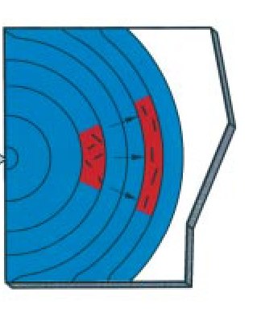
Mechanisms orienting the Fibres
Shear flow
Amorphous fibre-poor surface layer
Stretch flow
Shear oriented layer in flow direction
Stretch oriented layer transversally to the flow direction
fibres will be oriented by both mechanisms – shear and stretch flow
Notes:
At the begining of this training, we heard already about 2 kinds of flow acting during the injection moulding process -
shear flow and stretch flow.
These 2 types of flow are the drivnig forces to orient the fibres, when injecting a reinforced polymer.
Stretch flow is oriented mainly perpendicular to the melt propagation direction and dominates the melt in the core
therfore, fibres in the core region will be oriented likewise transversal to the melt flow direction.
Shear Flow, on the other hand, is oriented in melt propagation direction and dominates the melt near the wall.
This means, fibres near the wall are mainly oriented in the melt flow direction.
Due to the sudden freeze of the melt, when touching the wall of the tool, we find a thin surface layer, poor of fibres and with nearly amorphous conditions.

Slide 25
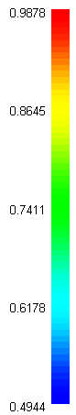
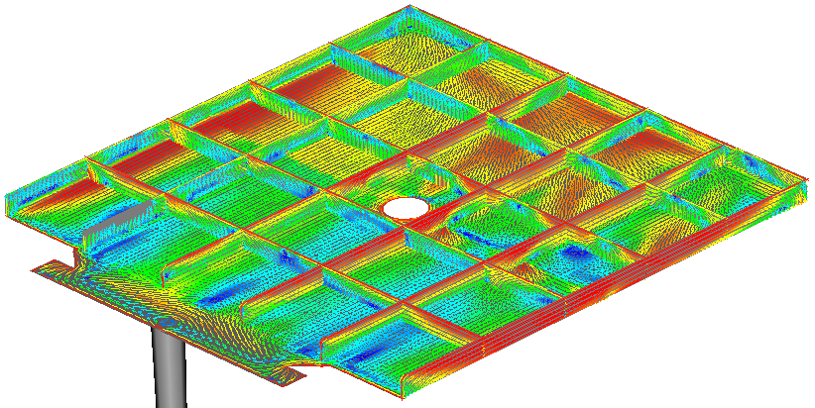
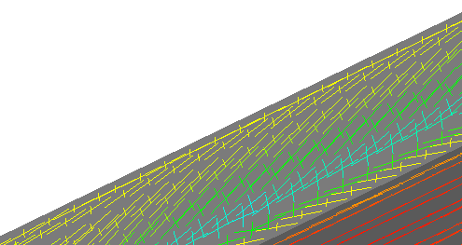
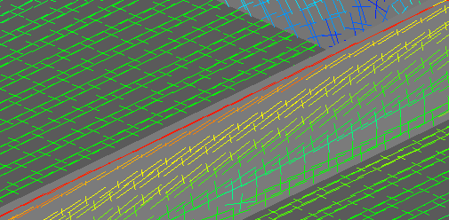
Example Orientation at Ribs
80%
60%
plate 100 x 100
90%
usually at top-edge higher orientation
75%
Notes:
This slide shows the fibre orientation of a ribbed plate.
The color indicate the intensity of orientation.
Red stand for high and bluw for low orientation.
When focusing onto a rib, we see on the upper right scetch a high intensity of orienation with 80% at the edge and a reduced orientation with 60% at the base of the rib.
Nearly the same result is displayed on the 2nd focus.
We can say:
That usually at top edges we find high fibre oeientations.

Slide 26
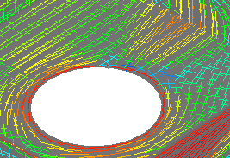
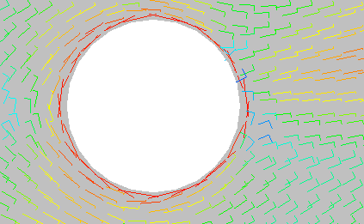
Example Orientation at Obstacles
90%
55% !!
90%
plate 100 x 100
55% !!
Notes:
In this example we investigate the fibre orientation behind obstacles.
Directly at the edge we find with 90% a high grade of orientation.
Behind the obstacle there are only 55%, which is quite low.
The reason for that is a weld line,
which originates from 2 meeting melt fronts.

Slide 27
Melt
Melt speed
Shear rate
Fibre orientation

